Slide 1
Integer Programming

Slide 2
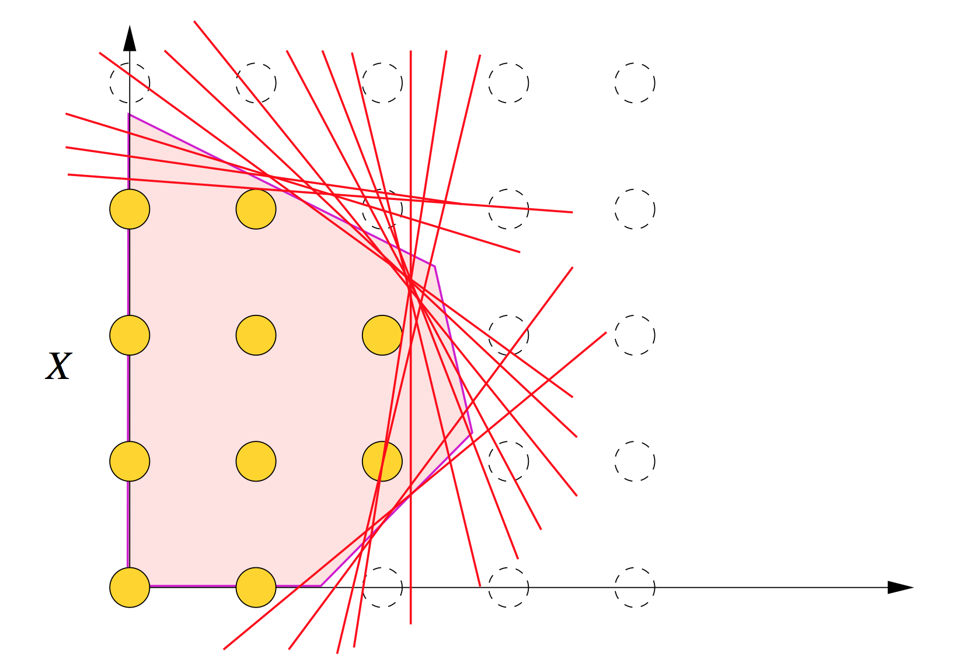
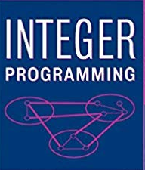
Problem Statement
Find weights (profit or loss probabilities) of each strategies based on past performace of strategies data to maximize the profit in the stock trading.

Slide 3
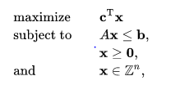

Use Cases
Using different strategies historical performance data find out optimal weights for each strategies to maximize the profit.
This optimization technique help us to identify strategies providing maximum profit. So that we can use them to generate more profit.
Also identify strategies which are generating loss or not generating profit needs to be observe frequently.

Slide 4
Data set
Motivation
Integer Programming only defined by objective function and constraints, it can be surprisingly applied to wide variety of problems
We can maximizing the expected profit from a stock market investment portfolio while minimizing the risk associated with it.
This optimization technique help us to find weights/probabilities of each feature/strategy involve in order to generate profit.
Datasets is used for training and testing purpose is 15 strategies returns consolidated file.
The dataset is divided into multiple iteration using Walk Forward Testing and trained accordingly

Slide 5
Technology stack
Approach
Python libraries:
1. Pulp
2. Pandas
3. Numpy
Python 3.7
Divided the data into train and test dataset.
Define problem statement as Maximize
Define Integer variables for each strategies weights/probabilities varies from 0 to 5.
Find Cummulative sum of train dataset and define objective function
Create constraints and solve the problem
Getting Solution for each strategies

Slide 6
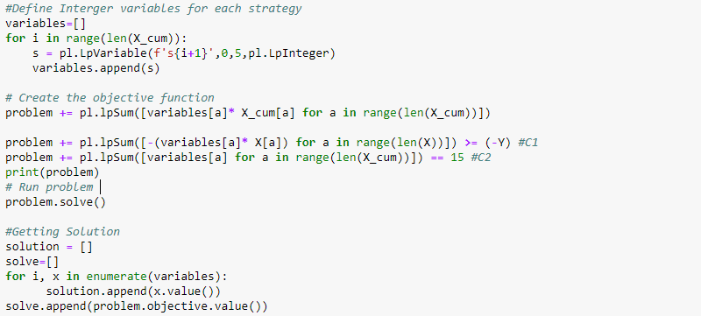
Sample Code

Slide 7
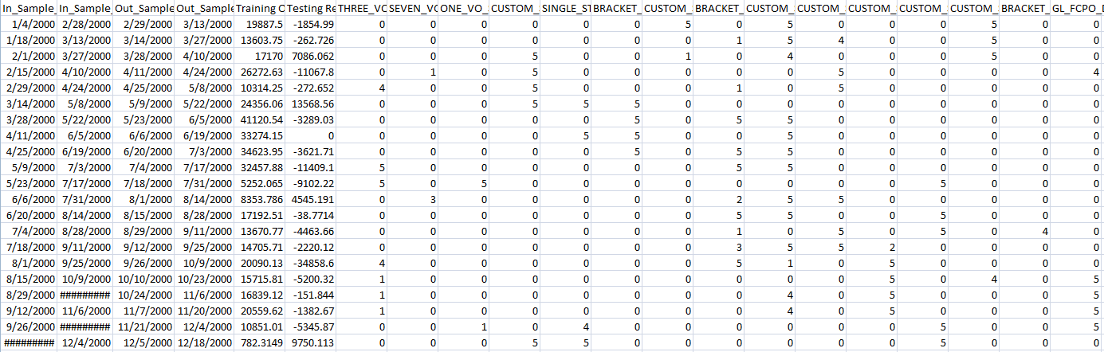
Results

